Slide 1




OVERVIEW OF GRAPH THEORY
VENU KANDAGATLA
Apr 06, 2019

Slide 2

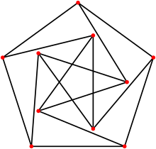

DEFINITION

Slide 3
Basic Vocabulary
PSEUDO GRPAHS – Allow edges connect a vertex to itself
SIMPLE GRPAHS – Non-empty set of vertices connected at most by one edge
MULTIGRPAHS – Allows multiples edges between two vertices
UNDIRECTED – unorder edges
DIRECTED – Ordered pairs of edges and vertices
DIRECTED MULTIGRAPHS
WEIGTED GRAPHS
WEIGHTED DIRECTED/UNDIRECTED
Two vertices are adjacent if there is an edge between them
The degree of a vertex in an undirected graph is the number of edges associated with it.
A graph in which every vertex has the same degree is called a regular graph
A simple graph is Complete Graph, if there is an edge between every pair of edge
A graph is connected, if there is a path between any two vertices

Slide 4
Applications
Calculating minimum required path between two locations
Analyzing the chemical bonding of elements
Finding communities network – Social media networks – facebook/linkedin
Ranking/ordering of hyperlinks – Google search results
Network applications to find minimum cost effective path to transfer the data between to computing devices

Slide 5
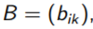
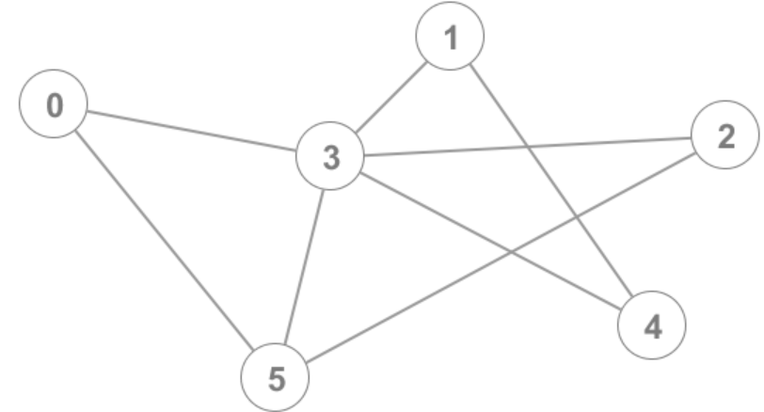
GRAPHS – Adjacency Matrix
V(G)
 | 0 | 1 | 2 | 3 | 4 | 5
0 | 0 | 0 | 0 | 1 | 0 | 1
1 | 0 | 0 | 0 | 1 | 1 | 0
2 | 0 | 0 | 0 | 1 | 0 | 1
3 | 1 | 1 | 1 | 0 | 1 | 1
4 | 0 | 1 | 0 | 1 | 0 | 0
5 | 1 | 0 | 1 | 1 | 0 | 0

Slide 6
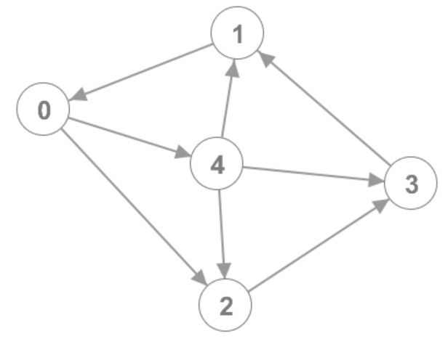
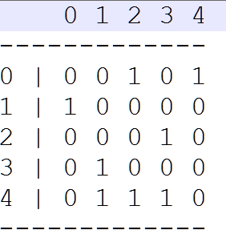
Graphs
DIRECTED GRAPHS – Adjacency Matrix

Slide 7
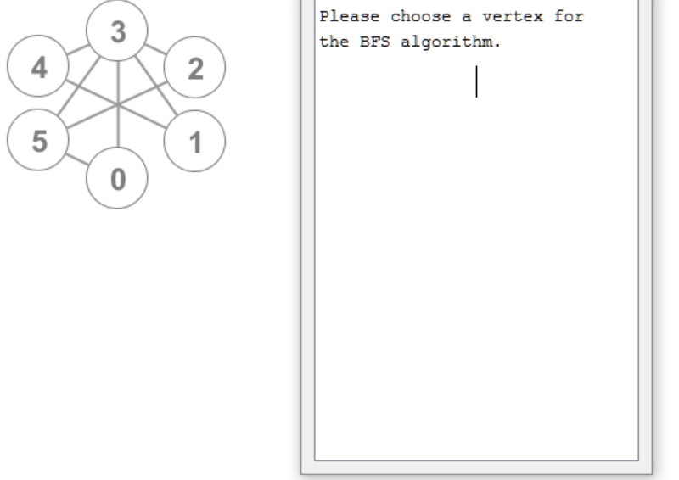
BFS

Slide 8
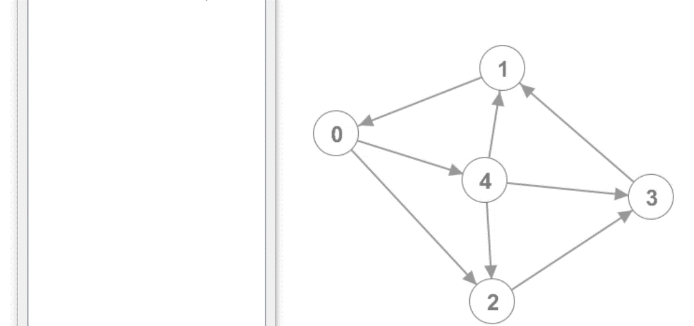
BFS

Slide 9
Q & A

Slide 10
QUIZ
Notes:
https://epa.ms/PEP-QUIZ-09042019

Slide 11
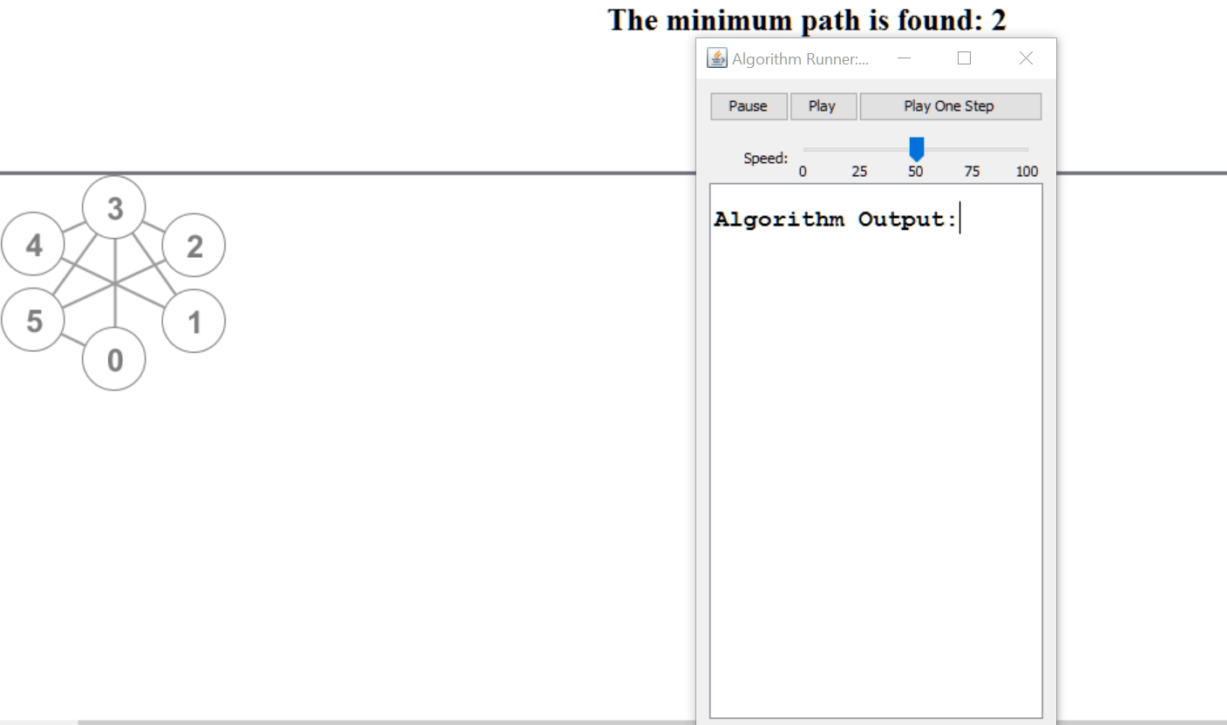
DFS

Slide 12
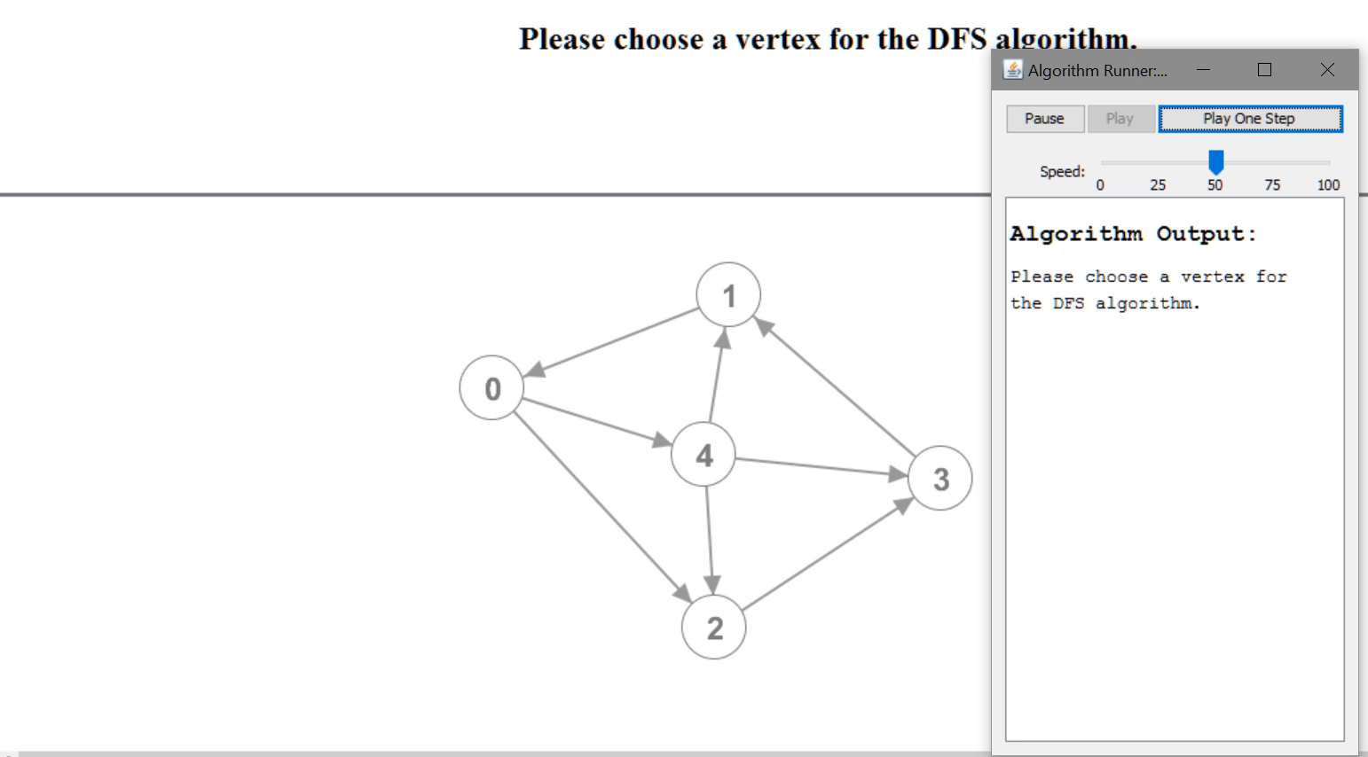
BFS

Slide 13
Q & A

Slide 14
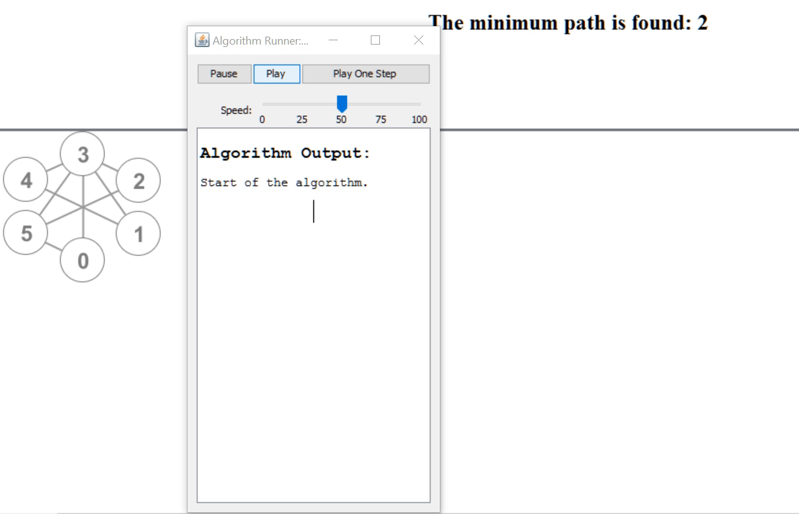
DIJKSTRA

Slide 15
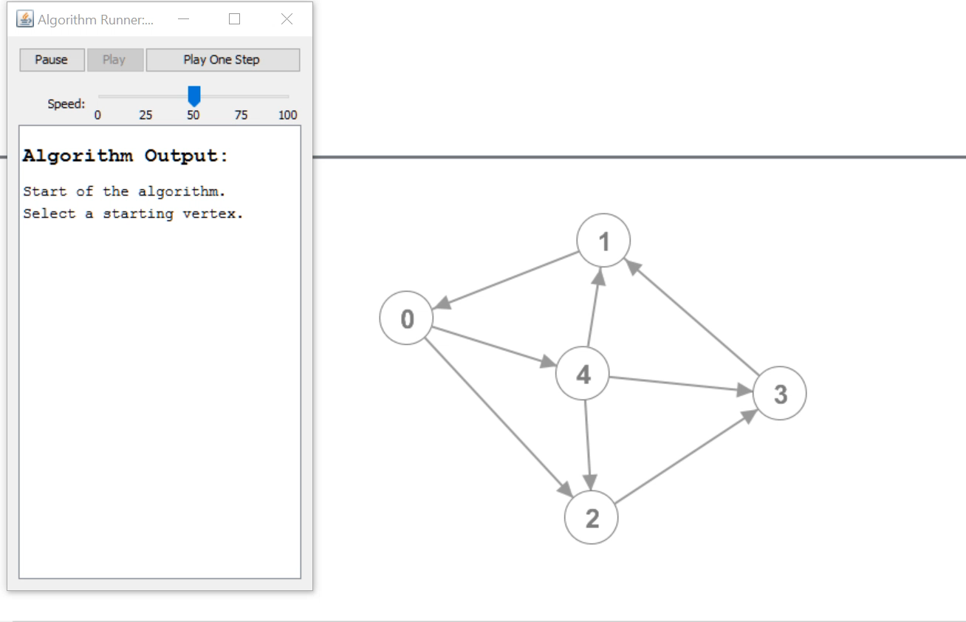
DIJKSTRA

Slide 16
Q & A

Slide 17
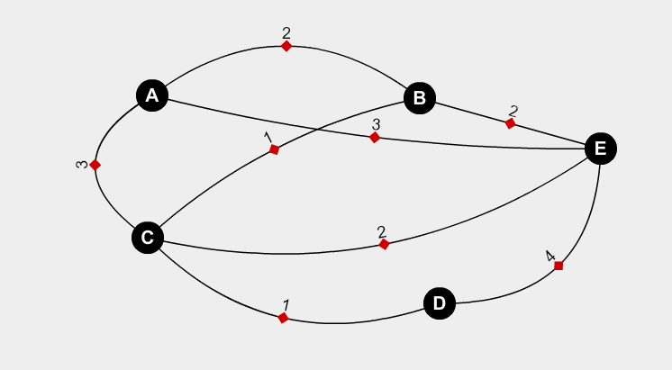
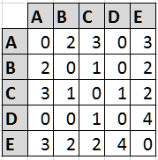
Weighted Undirected Graph

Slide 18
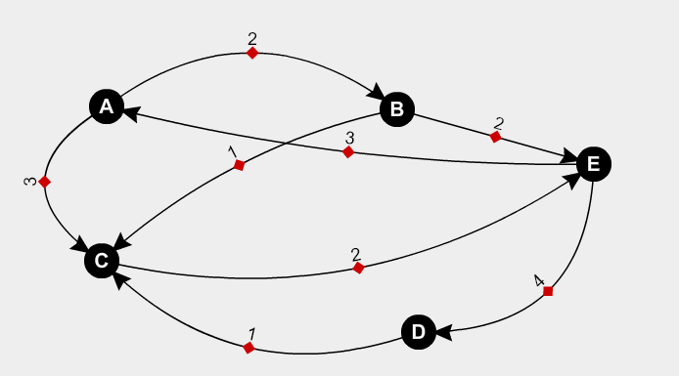
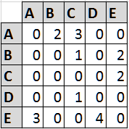
Weighted Directed Graph

Slide 19
Q & A

Slide 20
Resources
http://graphonline.ru/en/
http://www.graphtheorysoftware.com/
https://www.geogebra.org/graphing?lang=en
https://www.cs.cmu.edu/~adamchik/21-127/lectures/graphs_1_print.pdf
http://math.tut.fi/~ruohonen/GT_English.pdf
http://www.hamilton.ie/ollie/Downloads/Graph.pdf

Slide 21
Q & A

Slide 22
TASKS
https://www.hackerrank.com/challenges/torque-and-development/problem
https://www.hackerrank.com/challenges/bfsshortreach/problem
https://www.hackerrank.com/challenges/primsmstsub/problem
https://www.hackerrank.com/challenges/rust-murderer/problem
Submit Tasks here: https://epa.ms/PEP09042019
Last date: 26/04/2019

Slide 23
PRACTICE
https://www.hackerrank.com/domains/algorithms?filters%5Bsubdomains%5D%5B%5D=graph-theory&filters%5Bdifficulty%5D%5B%5D=medium&filters%5Bdifficulty%5D%5B%5D=easy

Slide 24
THANK YOU
VENU KANDAGATLA

